Slide 1

TrekPal
Ali Usman Tajik CIIT/FA22-BSE-134/ATD
Hasham Ali Khan CIIT/FA22-BSE-137/ATD
Supervisor: Maam Sana Malik
Department of Computer Science
COMSATS University Islamabad, Abbottabad Campus

Slide 2
Agenda of the Presentation
Brief Introduction
Scope
Functional Requirements
Non-Functional Requirements
User Goals
Use Cases
Use Case Diagram
Class Diagram
Sequence Diagram
Activity/State Machine Diagram
JSON Tree
Package Diagram
Deployment Diagram
Decision Table
Schedule (Gantt Chart)
Tasks for 1st Iteration(or 30%)
Details of 2nd Iteration (60%)
Conclusion

Slide 3
Brief Introduction
TrekPal is a unified travel-planning and booking ecosystem that connects Travelers, Travel Agencies, Transportation providers, and Hotel owners through a seamless digital platform.
The system enables Travelers to create trip requests, receive custom bids from multiple registered Travel Agencies, compare offers, and select the best one similar to a competitive marketplace.
TrekPal enhances transparency and convenience by integrating hotel booking, vehicle selection, trip customization, and group travel features into one solution.
The Admin Panel ensures verification, monitoring, and quality control across all users and agencies, enabling a trusted travel experience.

Slide 4
Scope
Travelers can create trip requests with destination, dates, and preferences.
Travel Agencies receive trip requests and submit hotel + transport bids.
Travelers can compare and accept bids to generate bookings automatically.
Agencies can post public trip advertisements for upcoming trips.
Travelers can browse and join posted group trips.
Basic in-app group chat for confirmed group trips.
Agencies can manage hotels, rooms,and vehicles.
Admin can verify agencies, hotels, and transport owners.
Admin can monitor complaints, users, and system activity.
Secure login/registration and role-based access control.
Backend supports trip requests, bids, bookings, and trip ads.
Database manages users, hotels, vehicles, trips, bids, and bookings.

Slide 5
Out of Scope
Online payment integration (Easypaisa/JazzCash/Stripe).
Real-time GPS tracking or navigation features.
AI-based trip recommendations or automated pricing.
Multi-currency or international travel support.
Offline functionality for app or agency portals.
Automated pricing or predictive analytics.

Slide 6
Functional Requirements
Traveler Functional Requirements
Traveler can register an account using email/phone/Google Sign-in.
Traveler can securely log in using Firebase Authentication.
Traveler can upload CNIC images for identity verification.
Traveler can search verified hotels using filters (location, rating, price).
Traveler can search approved transport vehicles by capacity, price, or availability.
Traveler can create Trip Requests with destination, dates, pax, and budget.
Traveler can view all active bids submitted by travel agencies.
Traveler can accept a bid and automatically generate hotel/transport bookings.
Traveler can join available group trips.
Traveler can participate in real-time group chat.
Traveler can submit reviews for hotels, vehicles, or agencies after trip completion.

Slide 7
Functional Requirements
Travel Agency Functional Requirements
Agency can register a business account and upload verification documents.
Agency can manage hotels (add, update, delete listings).
Agency can manage rooms and food menus under their hotels.
Agency can add and manage transport vehicles requiring admin approval.
Agency can define vehicle availability and pricing.
Agency can view traveler Trip Requests in a centralized marketplace.
Agency can submit structured bids referencing their own hotels and vehicles.
Agency can manage bookings after a bid is accepted.
Agency can optionally create tour packages with itinerary and pricing.

Slide 8
Functional Requirements
Admin Functional Requirements
Admin can approve or reject Travel Agency registrations.
Admin can approve or reject hotels submitted by agencies.
Admin can approve or reject vehicles submitted by agencies.
Admin can verify traveler identity documents.
Admin can moderate flagged content (reviews, chats, reports).
Admin can block or unblock travelers or agencies.
Admin can view analytics related to bookings, users, and agencies.

Slide 9
Non-Functional Requirements
Usability Requirements
The system shall provide a simple, intuitive, and easy-to-navigate UI across mobile and web.
The system shall show clear success and error messages for all user actions.
The onboarding process (registration + login) shall be quick and require minimal steps.

Slide 10
Non-Functional Requirements
Performance Requirements
All major screens and search results shall load within seconds.
Real-time chat messages shall deliver with a minimum delay
The system shall scale to support a large number of concurrent users without degradation.

Slide 11
User Goals
Traveler Goals
Easily find verified hotels and transport options for their trips.
Create trip requests and receive competitive bids from agencies.
Compare and accept the best travel package within their budget.
Join or create group trips for shared travel experiences.
Communicate with other travelers through chat.
Manage bookings, trip history, and reviews in one place.
Ensure safe and trustworthy bookings through verified agencies.

Slide 12
User Goals
Travel Agency Goals
Register their business and get verified on the platform.
Showcase and manage hotels, rooms, menus, and vehicles.
Receive trip requests and submit bids to acquire customers.
Increase sales by offering competitive packages to travelers.
Manage confirmed bookings efficiently through the agency dashboard.
Build reputation through traveler reviews and service quality.

Slide 13
Use Cases
Traveler Use Cases
UC-1 Register Account
UC-2 Complete Identity Verification
UC-3 Search Hotels
UC-4 Search Transport
UC-5 Create Trip Request
UC-6 View Bids
UC-7 Accept Bid
UC-8 Join Group Trip
UC-9 Group Chat
UC-10 Submit Review

Slide 14
Use Cases
Travel Agency Use Cases
UC-AG-01 Register Travel Agency
UC-AG-02 Submit Agency Verification Documents
UC-AG-03 Manage Hotels
UC-AG-04 Manage Rooms & Menus
UC-AG-05 Manage Vehicles
UC-AG-06 View Trip Requests
UC-AG-07 Submit Bid
UC-AG-08 Manage Accepted Bookings
UC-AG-09 Create Tour Packages (Optional)

Slide 15
Use Cases
Admin Use Cases
UC-ADM-01 Approve/Reject Travel Agency Registration
UC-ADM-02 Approve/Reject Hotels
UC-ADM-03 Approve/Reject Vehicles
UC-ADM-04 Approve Traveler Verification
UC-ADM-05 Moderate Content (Reviews/Chats)
UC-ADM-06 View Analytics
UC-ADM-07 Block/Unblock Users or Agencies

Slide 16
Use Case Diagram

Slide 17
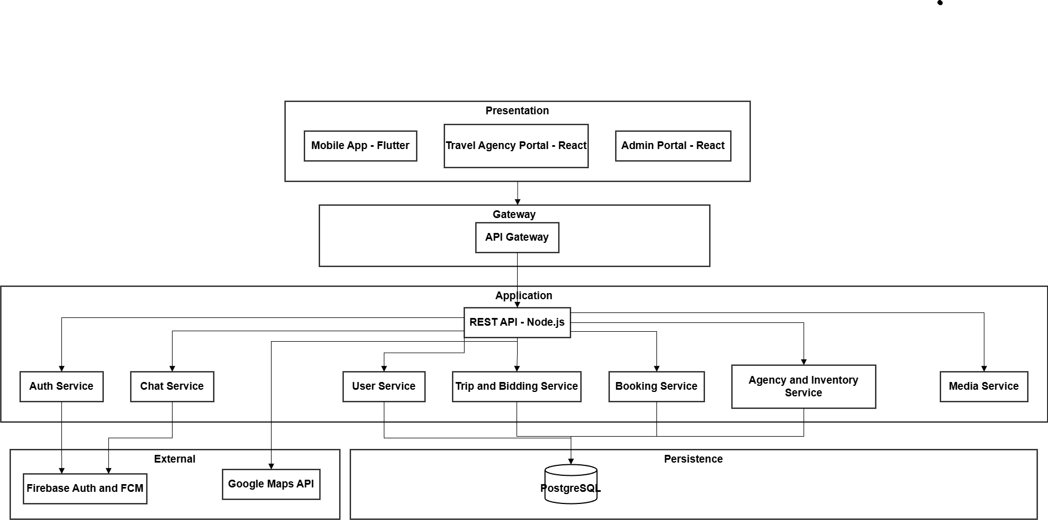
Archtecture Diagram

Slide 18
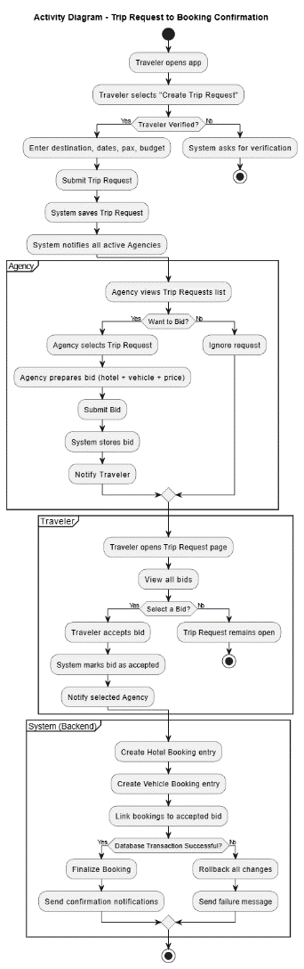
Activity Diagram

Slide 19
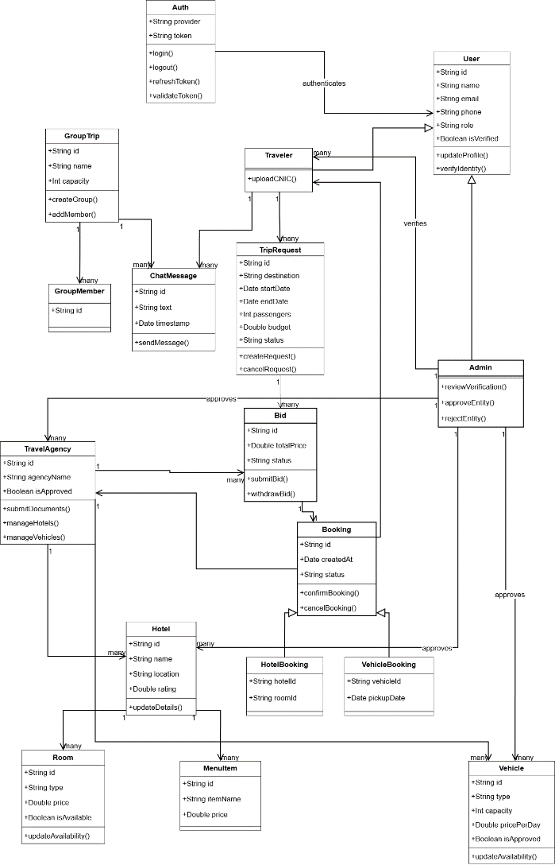
Class Diagram

Slide 20
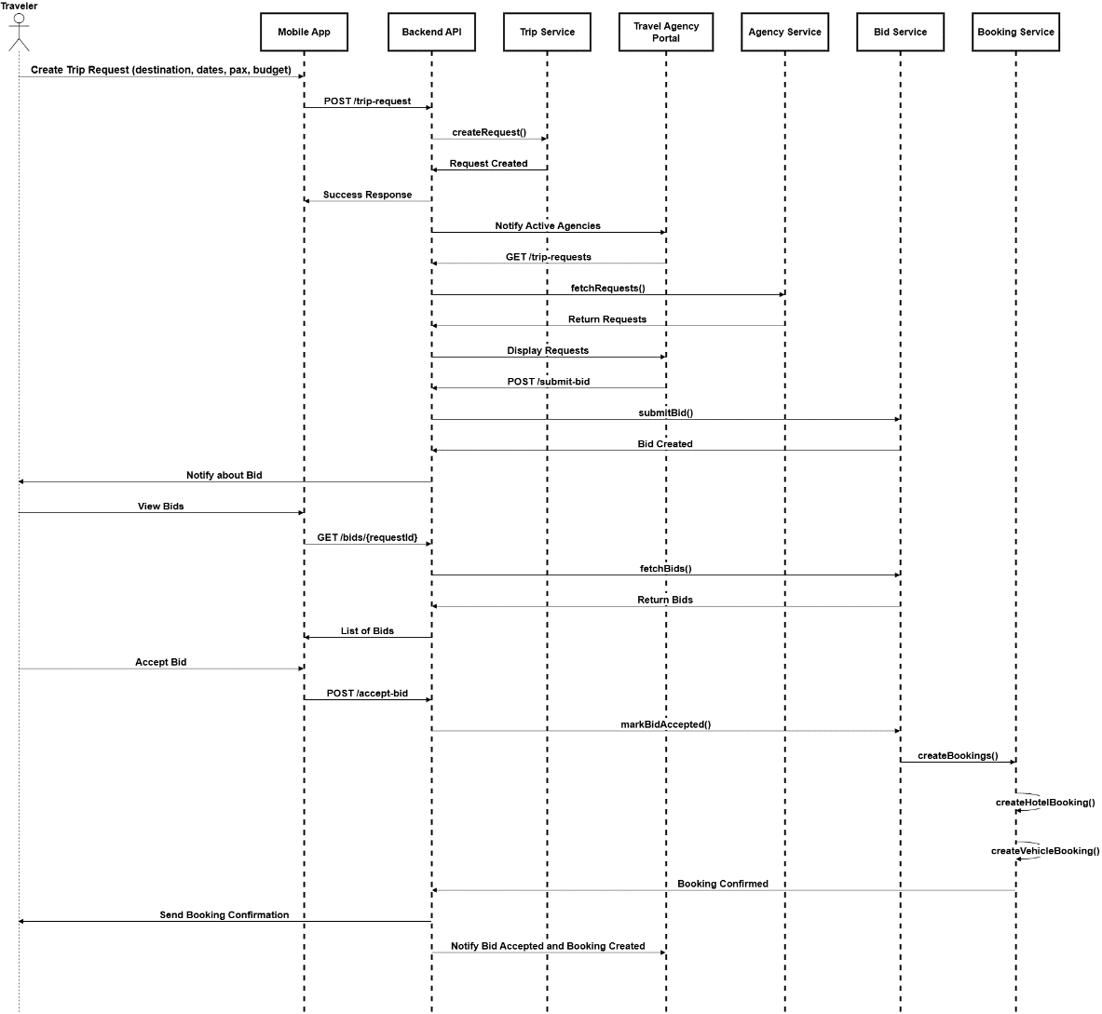
Sequence Diagram

Slide 21
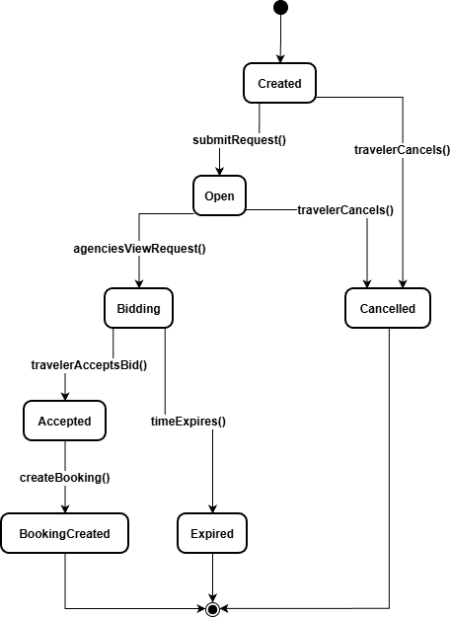
Activity/State Machine Diagram

Slide 22
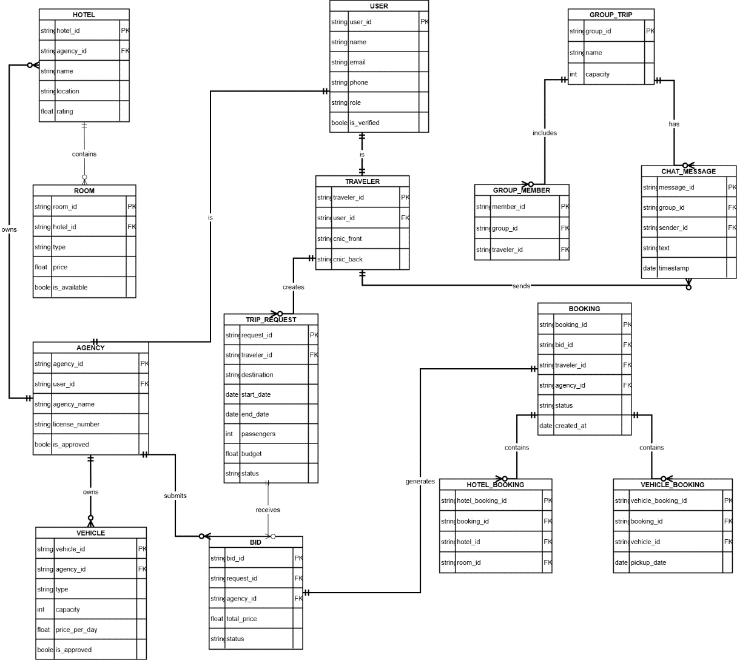
ER Diagram

Slide 23
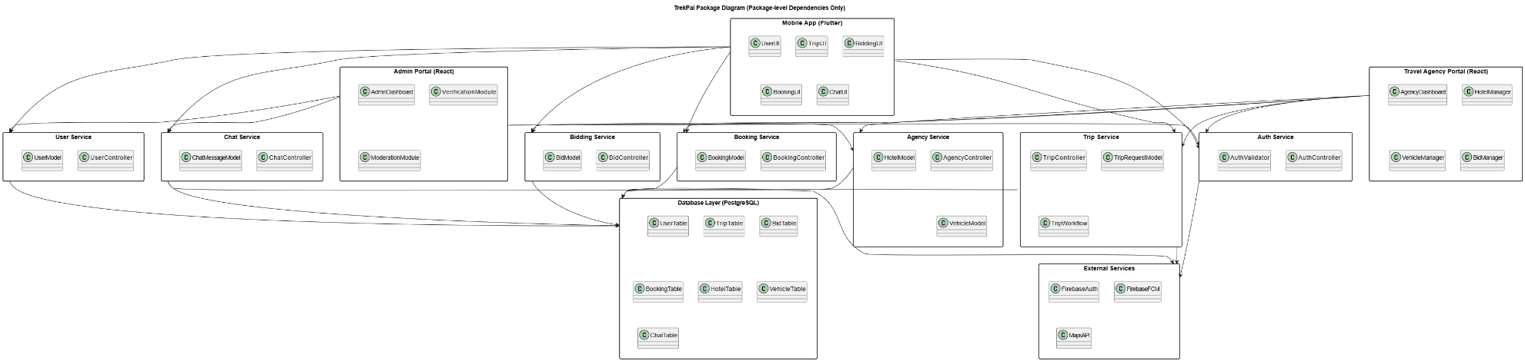
Package Diagram

Slide 24
Decision Table, Pseudocode
Use Case | Condition | Action Taken by System
Manage Hotels (Agency) | Agency submits hotel details | Save/Update hotel and forward to Admin for approval
Manage Vehicles (Agency) | Valid vehicle details uploaded | Save vehicle record and set status Pending Approval
Submit Bid (Agency) | Agency owns hotel/vehicle and price is valid | Create bid entry and notify Traveler
Manage Accepted Bookings (Agency) | Booking exists and update requested | Update booking status and notify Traveler
Approve/Reject Agency (Admin) | Valid documents available for review | Approve/Reject agency and notify them
Approve Hotel/Vehicle (Admin) | Listing submitted by agency | Approve or reject listing and update visibility
Moderate Content (Admin) | Flagged message/review exists | Remove or hide content and log moderation action
Block/Unblock Users (Admin) | Admin selects a user/agency | Update account status and restrict/unrestrict access
Logout | User clicks logout | Clear session/token and redirect to login screen

Slide 25
Decision Table, Pseudocode
Use Case | Condition | Action Taken by System
Register Account (Traveler/Agency) | User provides valid email & required details | Create account (Traveler via Firebase Auth, Agency stored as Pending Verification) and show success message
Login | Credentials are correct | Authenticate user with Firebase and redirect to dashboard
Identity Verification (Traveler) | CNIC front/back images uploaded | Upload images to storage, create verification request, notify Admin
Agency Verification | Required business documents uploaded | Store documents, mark agency as Pending, notify Admin
Search Hotels | Traveler provides destination/filters | Retrieve approved hotels from database and display results
Search Transport | Valid route/date parameters provided | Retrieve approved vehicles from database and show list
Create Trip Request | Traveler provides valid destination, dates, pax | Save Trip Request, mark status = OPEN, notify all agencies
View Bids | Bids exist for the Trip Request | Display all active bids submitted by agencies
Accept Bid | Bid is valid, active, and Traveler is verified | Mark bid Accepted, generate hotel/vehicle bookings, notify both Traveler & Agency
Join Group Trip | Seats available in group | Add user to group and update member list
Group Chat | User is a group member | Send chat message via WebSocket/FCM and store in DB
Submit Review | Booking is completed & review valid | Save review and display on relevant profile/hotel/vehicle

Slide 26
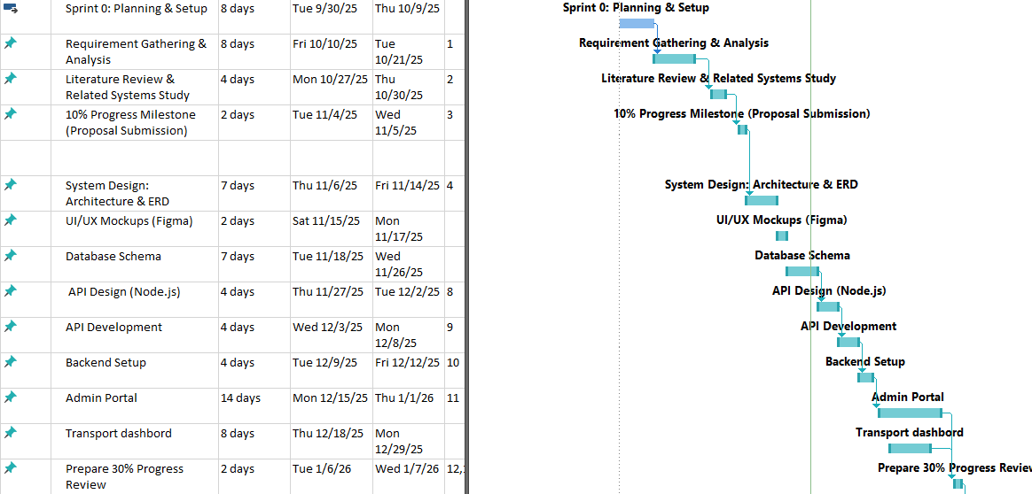
Schedule

Slide 27
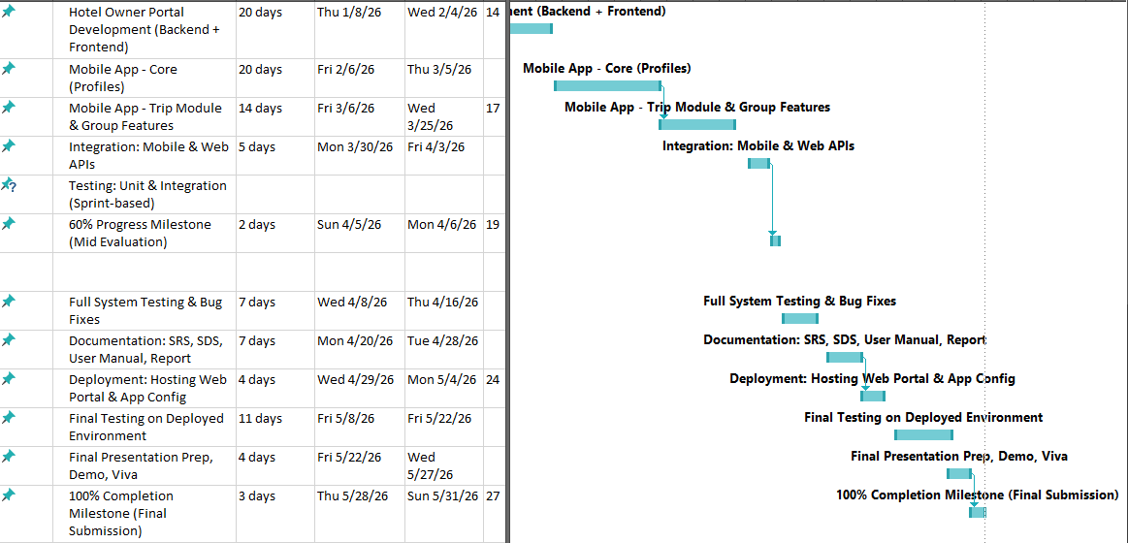
Schedule

Slide 28
Details of 1st Iteration (30%)
Complete system architecture design and ERD documentation.
Design the initial database schema aligned with system entities.
Design REST API structure and endpoints for Node.js backend.
Begin core API development for authentication and basic modules.
Set up backend environment, database connection, and project structure.
Develop the initial Admin Portal foundation (login, verification flows).
Develop the initial Admin Portal foundation (add hotels, add vehicle , login ,).
Build the Transport Module structure for vehicle management.

Slide 29
Details of 2nd Iteration (60%)
Complete Travel Agency Portal development (backend + frontend) including hotel, rooms, and vehicle management.
Implement core mobile app modules for traveler profiles and identity verification.
Develop Trip Request creation, bid viewing, and group trip joining features on the mobile app.
Integrate Mobile App and Agency Portal with backend REST APIs for trips, bids, bookings, and authentication.
Achieve the 60% milestone with a functional end-to-end flow:
Trip Request → Agency Bid → Bid Acceptance → Booking Creation.

Slide 30
Conclusion
TrekPal successfully integrates travelers, agencies, and administrators into a unified, reliable, and user-friendly travel management ecosystem. Through verified service providers, structured trip requests, competitive bidding, automated bookings, and real-time communication, the platform improves trust, transparency, and convenience in trip planning.
The system’s modular architecture, strong security measures, and scalable design ensure that TrekPal can grow and support advanced features in future iterations, delivering a complete and efficient travel experience for all users.

